Slide 1
Teaching Java using Turtles part 2
Barb Ericson
Georgia Institute of Technology
May 2006

Slide 2
Learning Goals
Create and initialize objects
  Using the new operator
  Passing values to initialize the new object
Declare variables
  To use objects again
Send messages to objects to ask them to do something
  Objects can do certain behaviors
  You ask an object to do a behavior by sending it a message
  Objects can refuse to do what you ask
Use turtles to draw simple shapes

Slide 3
Declaring a Variable
To be able to refer to an object again we need to specify what type of thing it is and give it a name
  This is also called declaring a variable
  Type name; OR
  Type name = new Class(value, value, …);
The equal sign doesn’t mean equal
  But assign the value of the variable on the left to the result of the stuff on the right
  The following creates a variable named earth which refers to a World object created on the right
    World earth = new World();
Notes:
A reference to an object is a way to calculate the address of the object in memory. It is not the address of the object. References are not pointers.

Slide 4
Declaring Variables
Variables are names associated with values
  If the type of the variable is null
    It doesn’t refer to an object yet
  Variables can be reused
    World earth = null;
    earth = new World();
    earth = new World();
earth
null
World
Object 1
earth
earth
World
Object 2

Slide 5


A Variable Associates a Name to Space
A variable is like a box with a label on it
  You can put something in a box
  You can take something out of a box
  You can even change what is in the box
  The size of the box restricts what you can put in it
Hat Box

Slide 6
Limits on Declaring Variables
You can't declare two variables with the same name!
    > World earth = new World();
    > World earth = new World();
    Error: Redefinition of 'earth'
You can change what an object variable refers to
    > World earth = new World();
    > earth = new World();
Notes:
The first example would try to name two different boxes with the same name. But, then how would you know which one is the right one when someone refers to that name?

Slide 7
Declaring Variables and Creating Objects
You can declare a variable and assign it to refer to a new object in one statement
  World earth1 = new World();
  Turtle tommy = new Turtle(earth1);
Declaration of variables
Creating the objects

Slide 8
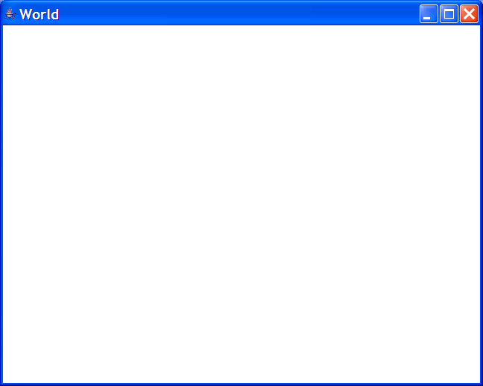

Turtle Basics
The world starts off with a size of 640 by 480
  With no turtles
  World earth1 = new World();
The turtle starts off facing north and in the center of the world by default
  You must pass a World object when you create the Turtle object
    Or you will get an error: java.lang.NoSuchMethodException: Turtle constructor
  Turtle tommy = new Turtle(earth1);
Notes:
A turtle must be created in a world or you will get an error java.lang.NoSuchMethodException: Turtle constructor.

Slide 9
Java Naming Conventions
Notice that we capitalize the names of the classes, but not the variable names
  World earth1 = new World();
  This is different than English
    Capitalize proper nouns (the names of things)
    Not the type of thing
      Earth is a world.
      Tommy is a turtle.
In Java it is the class names that are the most important
  Not the variable or method names

Slide 10

Creating Several Objects
You can create several World objects
  World mars = new World();
You can create several Turtle objects
  Turtle shar = new Turtle(mars);
  Turtle jen = new Turtle(mars);
  One turtle is on top of the other
Notes:
Turtles cycle through 4 different colors. The 5th turtle you create will have the same color as the first turtle.

Slide 11


Moving a Turtle
Turtles can move forward
  jen.forward();
  The default is to move by
    100 steps (pixels)
You can also tell the turtle how far to move
  shar.forward(50);
Notes:
Passing the amount to move forward by is also called passing a parameter.

Slide 12
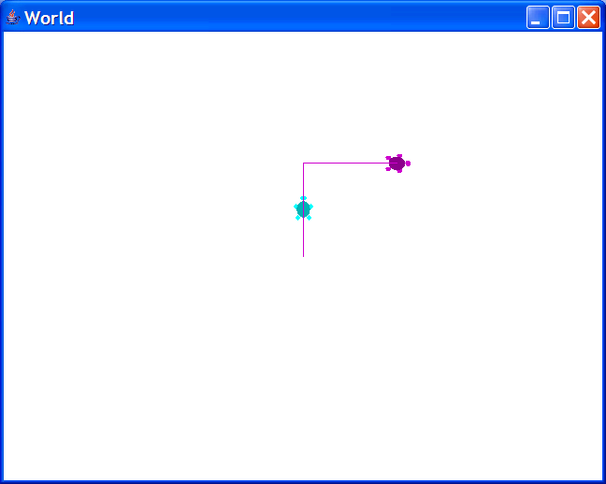
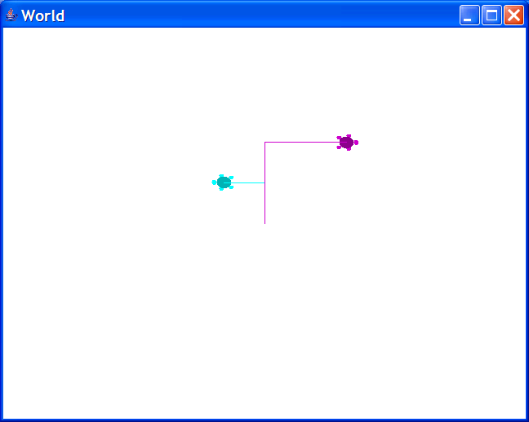
Turning a Turtle
Turtles can turn
  Right
    jen.turnRight();
    jen.forward();
  Left
    shar.turnLeft();
    shar.forward(50);
Notes:
Turtles turn by 90 degrees by default.

Slide 13
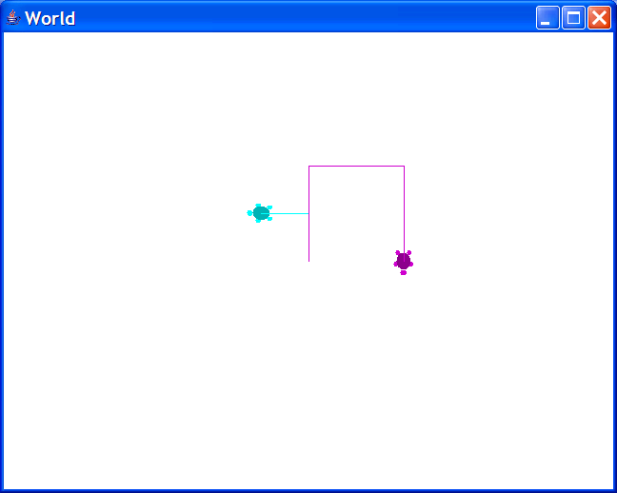
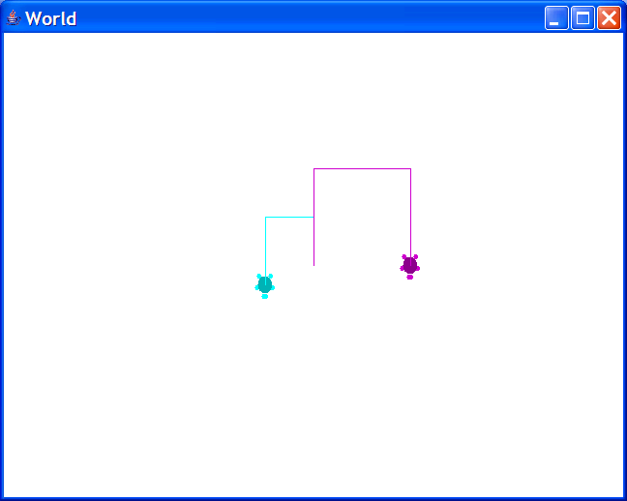
Turning a Turtle
Turtles can turn by a specified amount
  A positive number turns the turtle the right
    jen.turn(90);
    jen.forward(100);
  A negative number turns the turtle to the left
    shar.turn(-90);
    shar.forward(70);

Slide 14
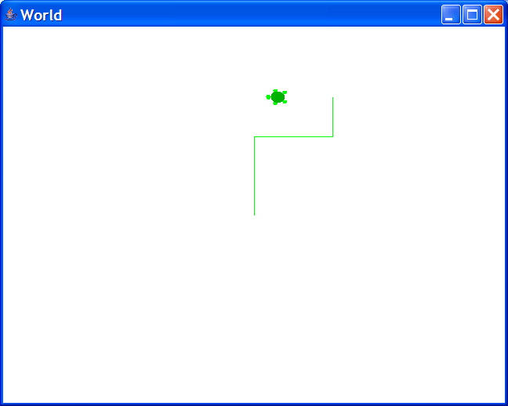
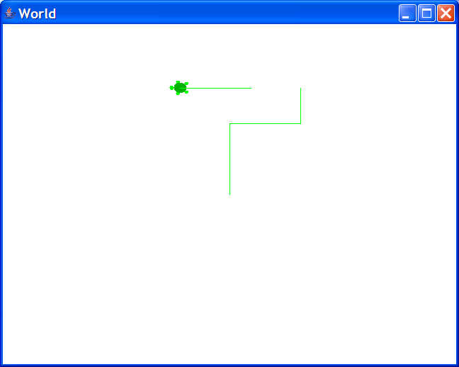
The Pen
Each turtle has a pen
  The default is to have the pen down to leave a trail
  You can pick it up:
    turtle1.penUp();
    turtle1.turn(-90);
    turtle1.forward(70);
  You can put it down again:
    turtle1.penDown();
    turtle1.forward(100);

Slide 15
Drawing a Letter
How would you use a turtle to draw a large letter T?
Process
  Create a World variable and a World object and a Turtle variable and object.
  Ask the Turtle object to go forward 100
  Ask the Turtle object to pick up the pen
  Ask the Turtle object to turn left
  Ask the Turtle object to go forward 25
  Ask the Turtle object to turn 180 degrees
  Ask the Turtle object to put down the pen
  Ask the Turtle object to go forward 50
Notes:
You can do these in the interactions pane.

Slide 16
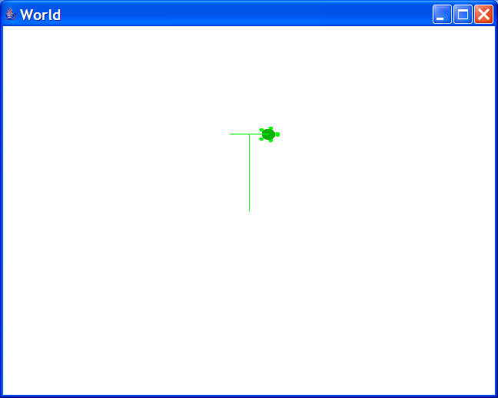
Drawing a T
World world1 = new World();
Turtle turtle1 = new Turtle(world1);
turtle1.forward(100);
turtle1.penUp();
turtle1.turnLeft();
turtle1.forward(25);
turtle1.turn(180);
turtle1.penDown();
turtle1.forward(50);

Slide 17
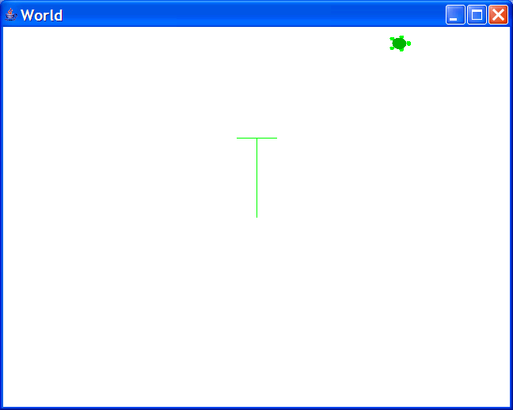
Moving to a Location
X
639
A turtle can move to a particular location
  turtle1.penUp();
  turtle1.moveTo(500,20);
Coordinates are given as x and y values
  X starts at 0 on the left and increases horizontally to the right
  Y starts at 0 at the top of the window and increases to the bottom
  A new turtle starts out at 320,240 by default
Y
479
Notes:
There are 640 pixels in the width (0 to 639) and 480 in the height (0 to 479).

Slide 18
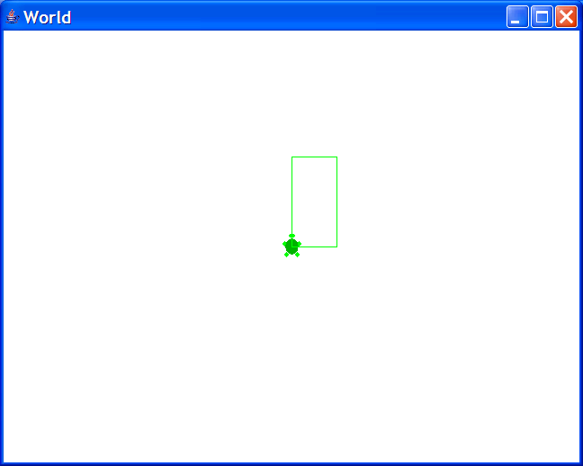
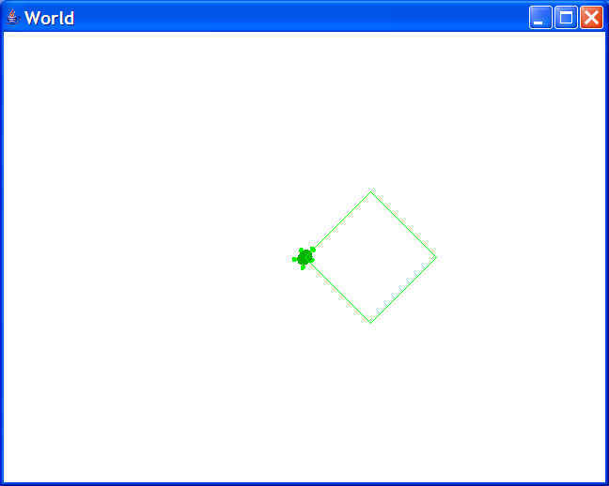
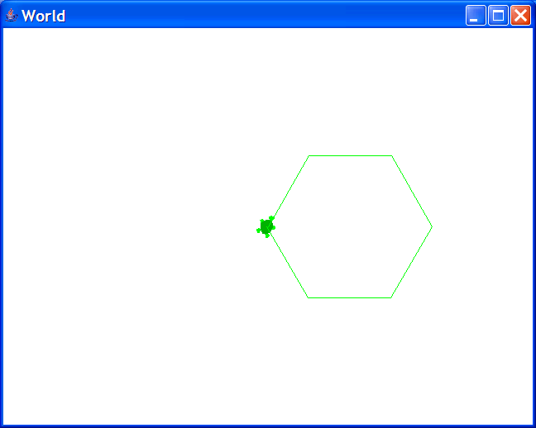
Challenge
Create a World object
  Don’t forget to declare a variable to hold a reference to it
Create a turtle object
  Don’t forget to declare a variable to hold a reference to it
Use the turtle to draw a
  Rectangle (but, not a square)
  Diamond
  Hexagon
Use the up arrow to reuse previous commands

Slide 19
Summary
Create and initialize objects
  new Class();
  new Class(value1,value2);
  new World();
Declare variables to reuse values and objects
  Type name = null;
  Type name = new Class();
  Type name = new Class(value1,value2);
  World earth = new World();
  Turtle tommy = new Turtle(earth);
Send messages to objects to ask them to do something
  objRef.message();
  objRef.message(value1,value2);
  tommy.turnLeft();
  tommy.forward(50);

